Slide 1
Supplier Risk Assessment
2018 SUMMER INTERNSHIP PRESENTATION
Chris Miller

Slide 2
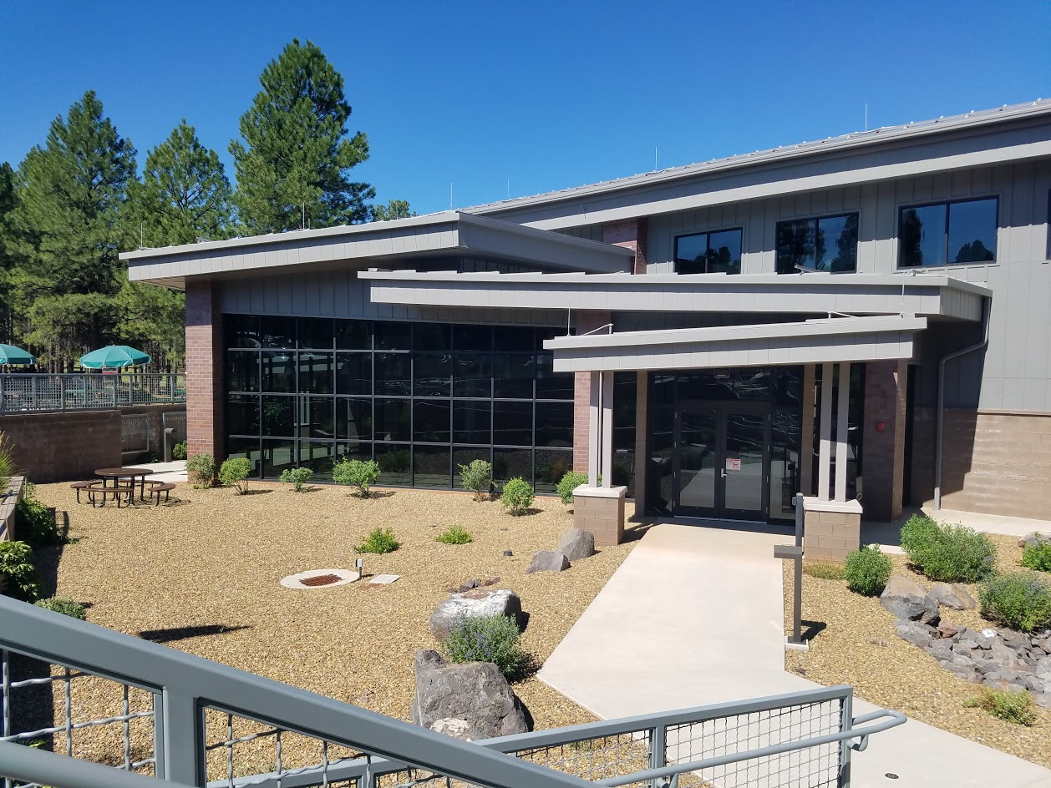


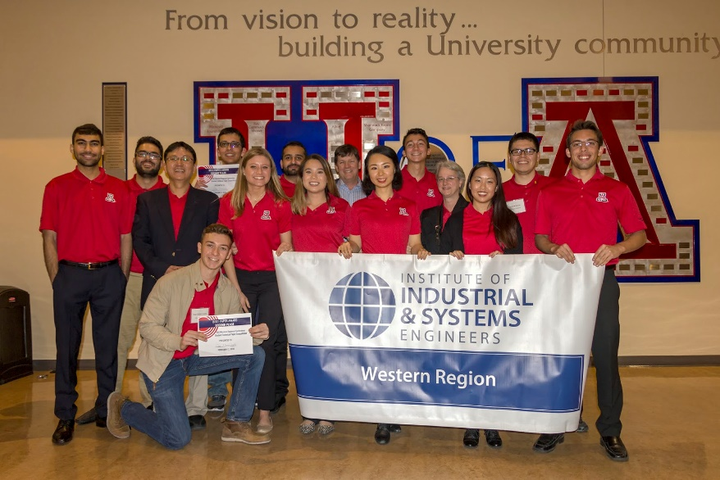

INTRODUCTION
Sponsor:
Buzz Baldwin
Chris Miller

Slide 3
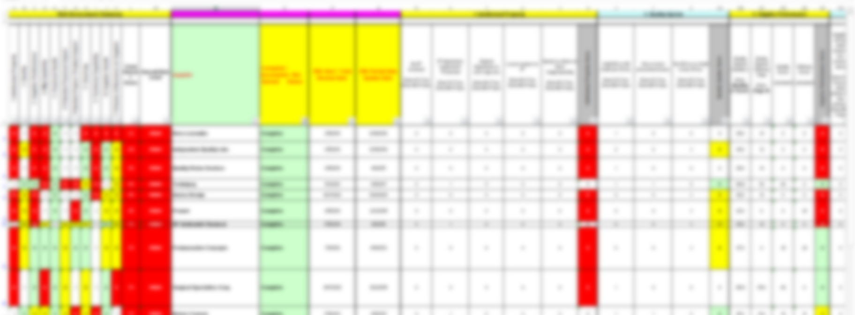
CURRENT STATE
Situation
The SRA scores a supplier’s risk in 12 different categories
Multiple questions per category, scores based on data
Used for vetting new suppliers for NPD projects, mitigating risk
The Problem?
Used Sporadically
Subjective Questions
Not user friendly
Takes too much time to complete

Slide 4
PROJECT CONCEPT STATEMENT
Enhance the robustness and effectiveness of the SRA by further defining the following criteria:
When is a SRA required and when should it be updated?
Ensure SROs/PoCs or some other ‘owner’ is captured for each supplier.
Define scoring levels (better definitions for scores 1-4)
Evaluate use of subjective vs. objective information(align on sources for data) to fill out SRA
How does SRA align with classification structure from MD84 (investigate vs business risk(SRA) vs. technical risk(MD84)
Frequency of reviewing SRA scores, how to maintain going forward? (ongoing documentation)
Is the SRA tracking the right information (ex. $100M impact question from Cathy)? (align with Enterprise/Tony Souris)
Where and how is the SRA information made available? (is it self-service for product teams?)

Slide 5
ALIGNMENT
Procurement
Leadership
The SRA should be the method for handling supplier risk and the core of the Strategic Sourcing Team.
This does not work if the team is not using it!
My project was to
bridge that gap
Make Procurement Leadership’s vision more practical
Methodically address supplier risk

Slide 6
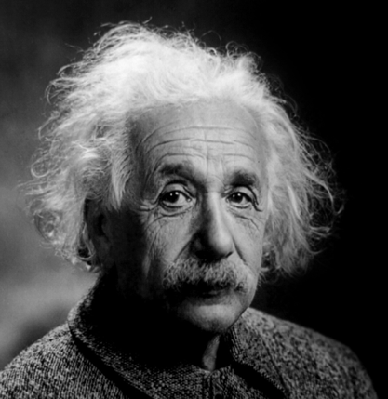
PROJECT APPROACH
Make Sure to Answer the Right Questions
Be Methodical Every Step of the Way
Gather Requirements
Develop a Plan
Execute and Adjust if Needed
“If I were given an hour in which to do a problem upon which my life depended, I would spend 40 minutes studying it, 15 minutes reviewing it and 5 minutes solving it.”
-Albert Einstein

Slide 7
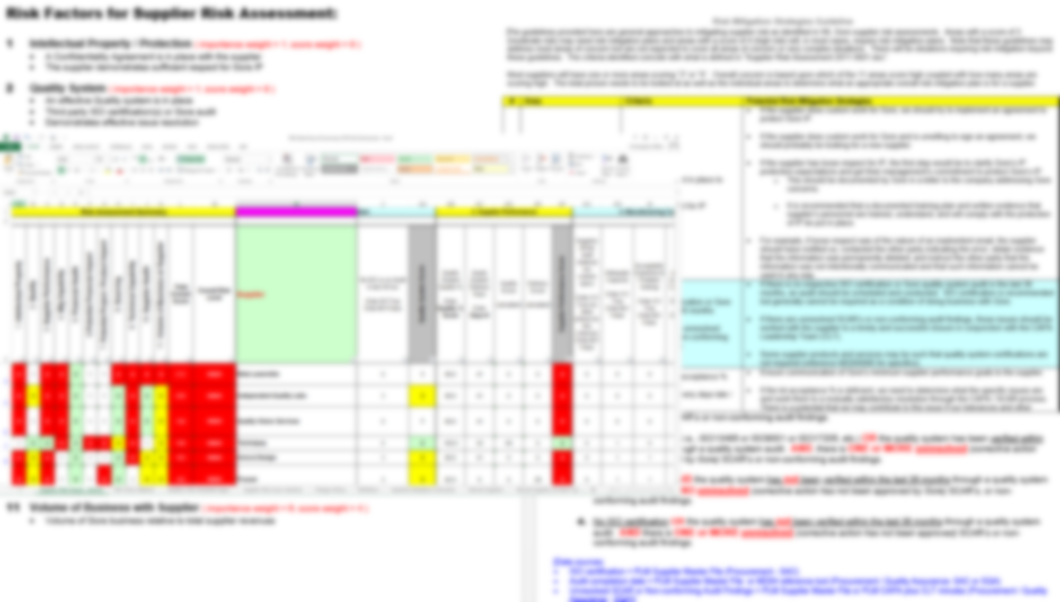
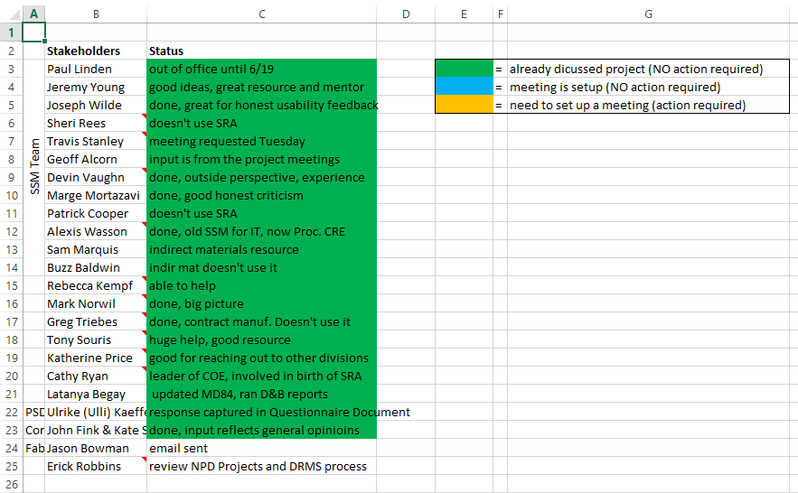
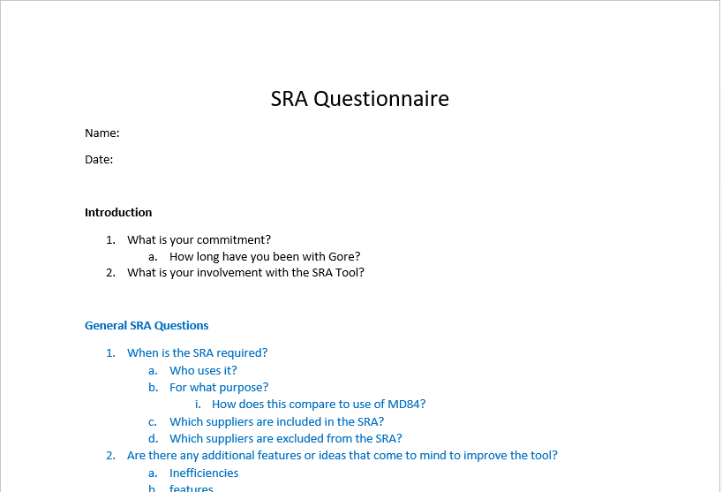
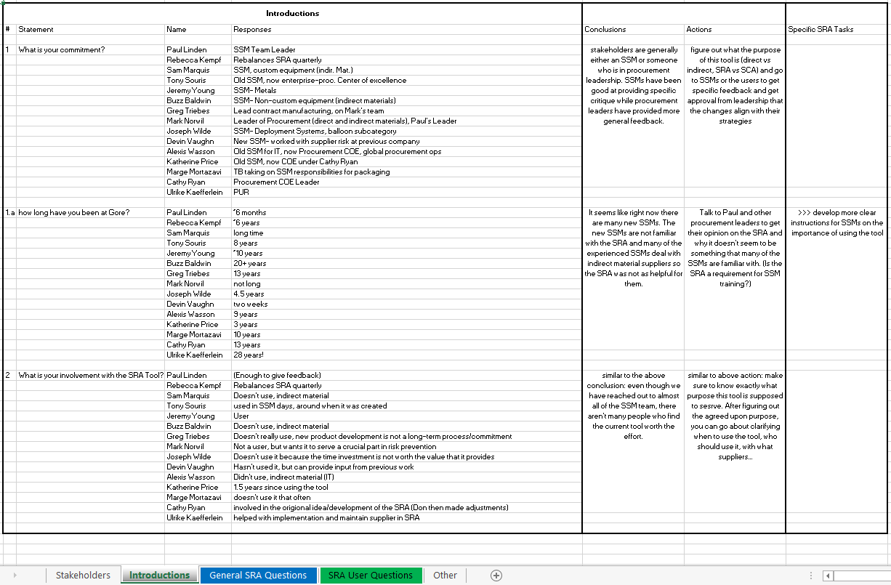
SRA Documentation
SRA Stakeholders
SRA Questionnaire
SRA Responses
Notes:
Only blur the supplier name

Slide 8
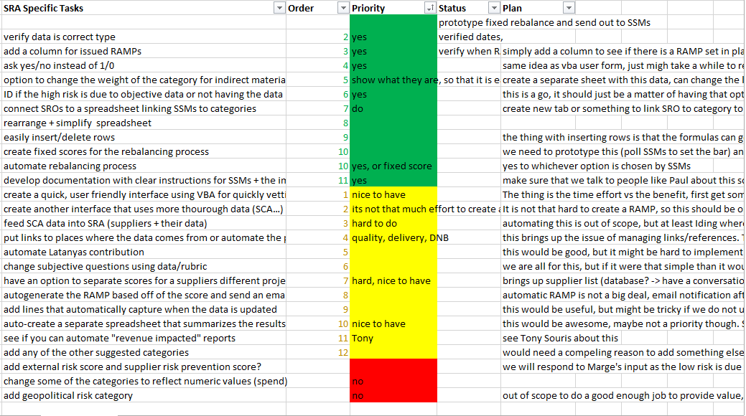
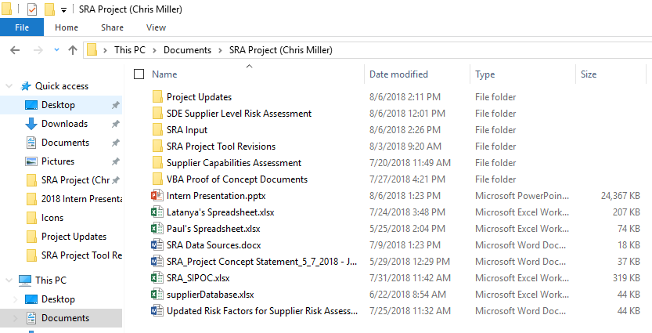
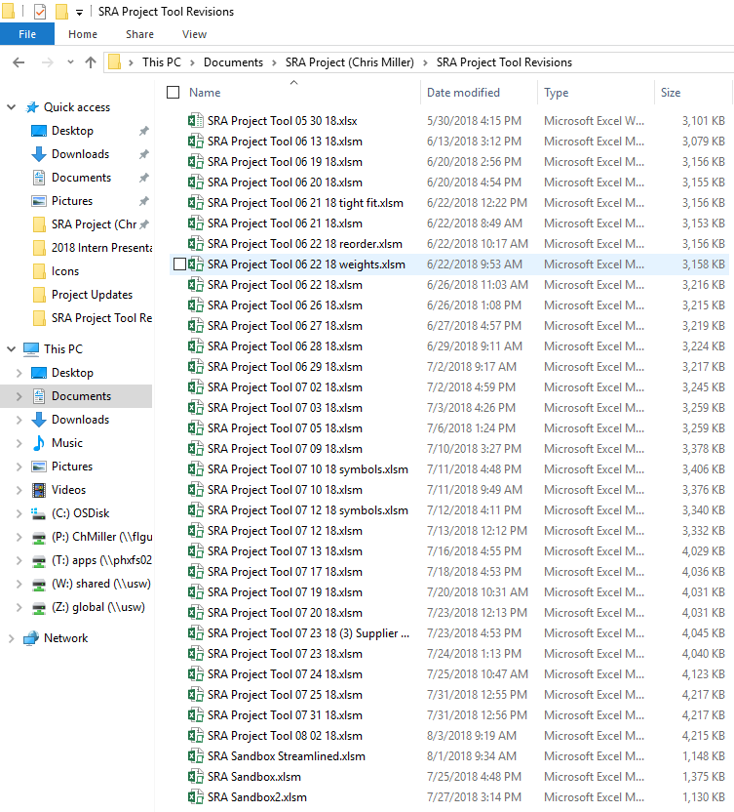
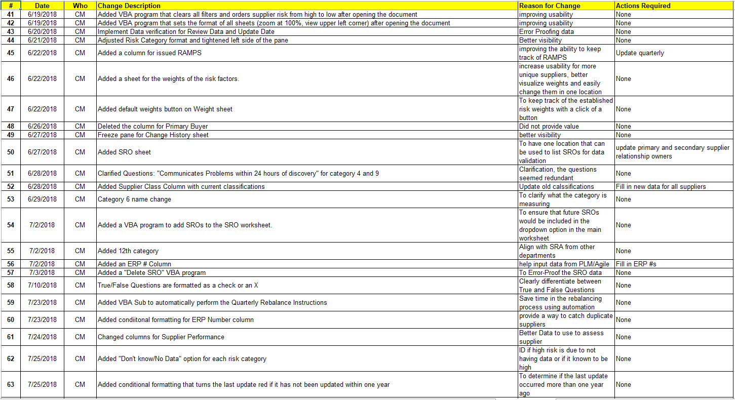
SRA Tasks
SRA Project Folder
Project Revisions
Change History

Slide 9
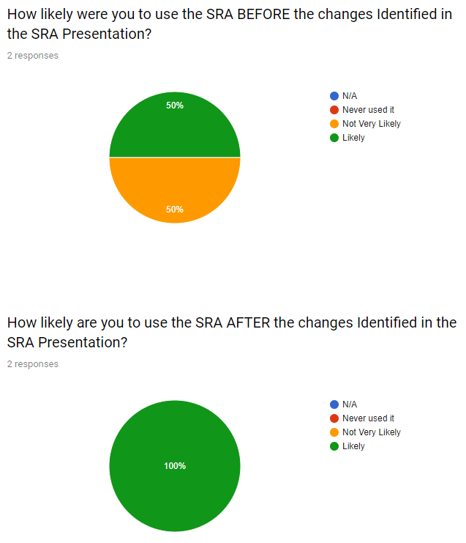




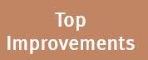

RESULTS/CONTRIBUTION
Quantitative Results
Top Improvements
Qualitative Results
34 Revisions
23 Improvements in change history
100% of focus tasks completed
3 nice-to-have tasks completed
SRA Sandbox Streamlined
Automated Rebalance
SRA Data Spreadsheet
SRO Sheet
Weight Sheet

Slide 10
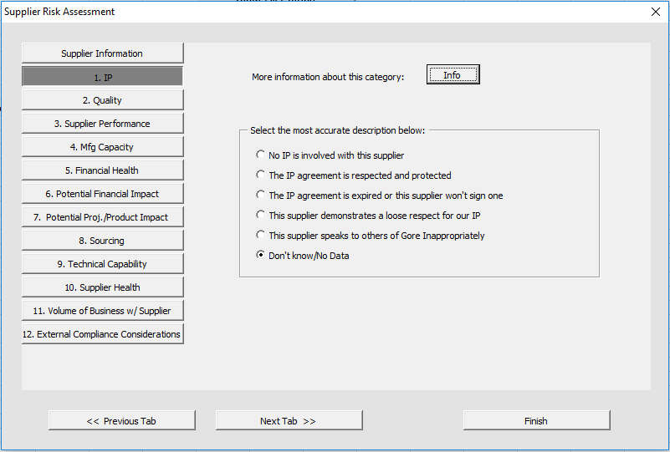
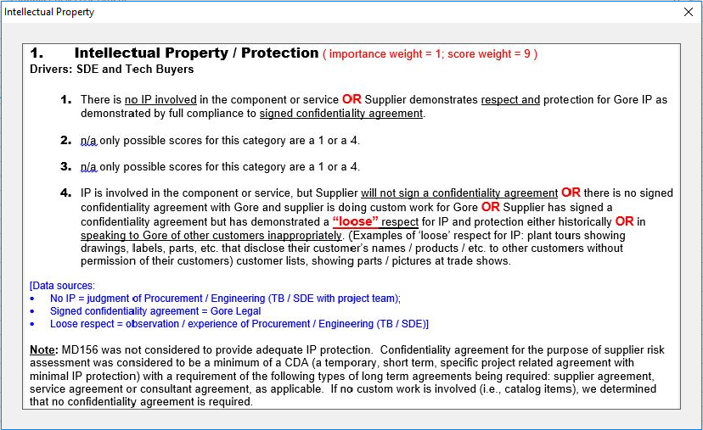
Notes:
Mention error-proofing (poka-yoke) here

Slide 11
SUSTAINMENT
Phase 1 (completed)
Usability
Phase 2 (short-term)
Cleanup
Phase 3 (long-term)
Increase risk capability
Project to Supplier relationship
SRA Champion: Paul Linden
SRA Documentation
Categories 6 and 7
Categories 6 and 7
Notes:
Tony’s Tool
SROs, class 4 suppliers
Automated reports
Map of tier 1 and 2 suppliers

Slide 12
KEY LEARNINGS
Lessons for School
Apply Methodical Approach
Consult Stakeholders and Solve Problems
Supply Chain & Strategic Sourcing
Gore Culture
Alignment with personal values
Continuous Improvement
Adapt to Business World

Slide 13
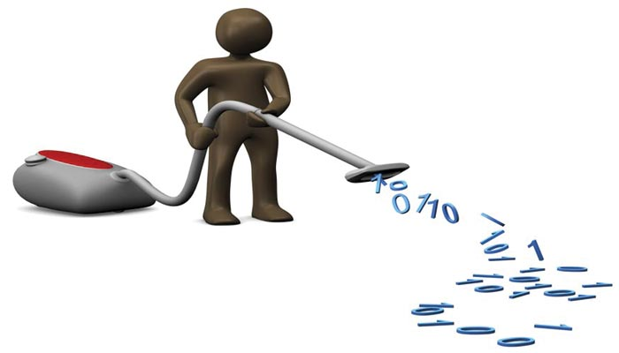

PROJECT CONCEPT STATEMENT
Enhance the robustness and effectiveness of the SRA by further defining the following criteria:
When is a SRA required and when should it be updated?
Ensure SROs/PoCs or some other ‘owner’ is captured for each supplier.
Define scoring levels (better definitions for scores 1-4)
Evaluate use of subjective vs. objective information(align on sources for data) to fill out SRA
How does SRA align with classification structure from MD84 (investigate vs business risk(SRA) vs. technical risk(MD84)
Frequency of reviewing SRA scores, how to maintain going forward? (ongoing documentation)
Is the SRA tracking the right information (ex. $100M impact question from Cathy)? (align with Enterprise/Tony Souris)
Where and how is the SRA information made available? (is it self-service for product teams?)
Phase 1
Phase 2
Phase 3

Slide 14
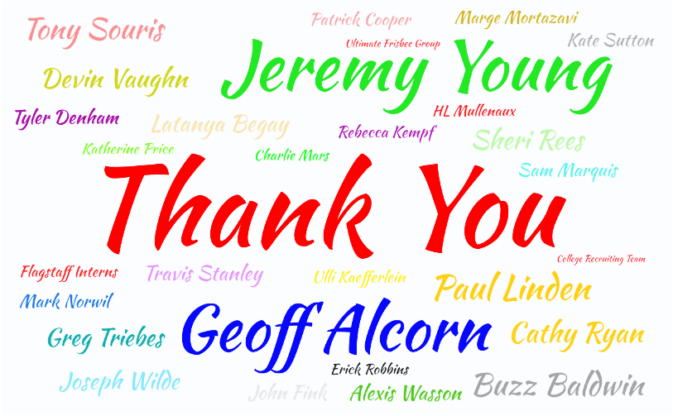
THANK YOU
https://wordart.com/create

Slide 15

QUESTIONS?

